Slide 1
Workshop in experimental design and applied statistics: Day 2
Curriculum and educational materials developed by Maegen Simmonds
R Stats App developed by Ian King Kyle, Jason Moore, and Maegen Simmonds Funded by USAID and CYMMYT
This work is licensed under a Creative Commons Attribution 4.0 International License, which encourages you to remix and reuse. Give credit where credit is due.
Notes:
Welcome back!

Slide 2
Workshop Goals
To understand experimental design and principles of statistical analysis to produce trustworthy results and interpretations.
To learn how to use the free the free R Stats App to analyze and visualize your data
Notes:
Recall

Slide 3
Overview of experimental setups covered in this workshop and that can be analyzed with the App:
Experimental Design | What is it? | Number of factors? | Number of treatment levels? | Number of study sites
Complete Randomized Design (CRD) | Treatments randomly assigned to experimental units without grouping | 1 or 2 factors (e.g. nitrogen rate and/or variety) | Unlimited (e.g. 4 levels of fertilizer rates: 0, 50 150, 200 kg/ha) | Unlimited
Randomized Complete Block Design (RCBD) | Treatments are randomly assigned to experimental units within groups (blocks) | 1 or 2 factors | Unlimited | Unlimited
Split-plot design | Two levels of randomization, at the main-plot and sub-plot level. | 2 factors | Unlimited | Unlimited
Notes:
Notice difference in each experimental design is about how you randomize treatment assignments.

Slide 4
What are we doing today?
Instruction 9:00 – 11:00 AM
Section 4: Testing assumptions of ANOVA and transforming data
Tea break 11:00 – 11:30 AM
Instruction 11:30 – 1:00 PM
Section 5: Presenting results, and RCBD with factorial treatment structure
Lunch 1:00 – 2:00 PM
Instruction 2:00 – 2:30 PM
Section 6: Split plot experimental design
Tea break 2:30 – 3:00 PM
Instruction 3:00 - 4:00 PM
Section 7: Multi-location studies, missing data

Slide 5


Have data. Want analysis.
valid

Slide 6

What are the assumptions of ANOVA? Which ones have you tested before?

Slide 7
Section 4 Learning Objectives
You will gain a basic understanding of:
The assumptions of ANOVA and transformations
Know the assumptions, and how to check your data
What to do when assumption tests fail, and what transformation to choose for your data
How to do all of this with the app!

Slide 8
Follow these four key assumptions of ANOVA to ensure that your analysis and conclusions are valid and correct:
ANOVA Assumptions | When might I have a problem?
1. Errors are statistically independent | Did I forget to randomly assign treatments to experimental units?(e.g. fertilizer rate treatments assigned to plots)
2. Additive effects: the variables are added, not multiplied | Does the effect of the treatment depend on what block they’re in?
3. Normal distribution of errors | Do the data represent a rare event, or are there outliers?
4. Equal differences (variance) within treatments | Is there a very strong treatment effect, or is this a multi-site study?
Notes:
Errors = (Predicted – Observed). “Predicted: Is basically the value that would be predicted for an individual measurement minus what was actually observed.

Slide 9
Ensure this by randomizing treatment assignments to experimental units!
ANOVA Assumptions | When might I have a problem?
1. Errors are statistically independent | Did I forget to randomly assign treatments to experimental units?(e.g. fertilizer rate treatments assigned to plots)
2. Additive effects: the variables are added, not multiplied | Does the effect of the treatment depend on what block they’re in?
3. Normal distribution of errors | Do the data represent a rare event, or are there outliers?
4. Equal differences (variance) within treatments | Is there a very strong treatment effect, or is this a multi-site study?

Slide 10
ANOVA Assumptions | When might I have a problem?
1. Errors are statistically independent | Did I forget to randomly assign treatments to experimental units?(e.g. fertilizer rate treatments assigned to plots)
2. Additive effects: the variables are added, not multiplied | Does the effect of the treatments depend on what block they’re in?
3. Normal distribution of errors | Do the data represent a rare event, or are there outliers?
4. Equal differences (variance) within treatments | Is there a very strong treatment effect, or is this a multi-site study?
It’s standard practice to perform statistical tests for #3 and #4, and include it in materials and methods section of research reports.

Slide 11
The app will give you the assumption test results, but YOU must interpret and address any problems.
(we will learn how)
ANOVA Assumptions | When might I have a problem?
1. Errors are statistically independent | Did I forget to randomly assign treatments to experimental units?(e.g. fertilizer rate treatments assigned to plots)
2. Additive effects: the variables are added, not multiplied | Does the effect of the treatments depend on what block they’re in?
3. Normal distribution of errors | Do the data represent a rare event, or are there outliers?
4. Equal differences (variance) within treatments | Is there a very strong treatment effect, or is this a multi-site study?
It’s standard practice to perform statistical tests for #3 and #4, and include it in materials and methods section of research reports.

Slide 12
ANOVA Assumptions | When might I have a problem?
1. Errors are statistically independent | Did I forget to randomly assign treatments to experimental units?(e.g. fertilizer rate treatments assigned to plots)
2. Additive effects: the variables are added, not multiplied | Does the effect of the treatments depend on what block they’re in?
3. Normal distribution of errors | Do the data represent a rare event, or are there outliers?
4. Equal differences (variance) within treatments | Is there a very strong treatment effect, or is this a multi-site study?
The app provides test results for this too! *Only for basic RCBD with 1 replication per block.

Slide 13
Inspect all assumption tests and corresponding plots from the app output before looking at ANOVA table

Slide 14
Let’s use the app to check the ANOVA assumptions on the wheat variety dataset (RCBD) from yesterday (wheat_yield_data.csv)
Normality
Equal variance
Additivity (only for RCBD with 1 replication per block)

Slide 15
Let’s use the app to check the ANOVA assumptions on the wheat variety dataset (RCBD) from yesterday (wheat_yield_data.csv)
Normality
Equal varience
Additivity (only for RCBD with 1 replication per block)

Slide 16
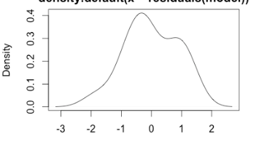
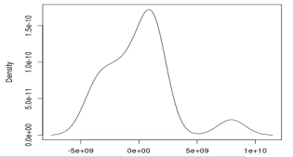
Shapiro-Wilk Normality Test
Good (Wheat example) | Bad
p-value > 0.05
CONCLUSION: Errors are normally distributed.
p-value ≤ 0.05
CONCLUSION: Errors are not normally distributed.
W = 0.9472 , p-value = 0.4471
W = 0.8784 , p-value = 0.0367
Kernel Density of the Residuals
Kernel Density of the Residuals
Density plot
Close to symmetric with center at x=0 ≈ normal
Not symmetric ≠normal
Density
Density
Residuals
-1 0 1 2
Residuals

Slide 17
Wheat variety dataset:
Normality
Equal variance
Additivity

Slide 18
Wheat variety dataset:
Normality
Equal variance
Additivity

Slide 19
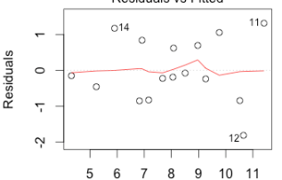
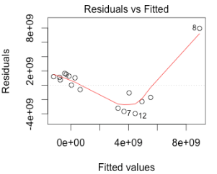
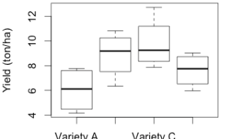
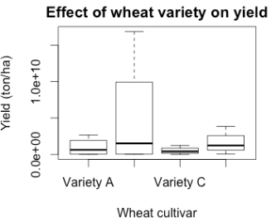
Levene’s Test for Equal Variance
Good (Wheat example) | Bad
p-value > 0.05
CONCLUSION: Equal variance across treatments levels.
p-value ≤ 0.05
CONCLUSION: Treatment variances are not equal.
 | Df | F value | Pr(>F)
group | 3 | 0.1623 | 0.9197
 | Df | F value | Pr(>F)
group | 3 | 1.4178 | 0.0286
No pattern/cloud of residuals ➔ equal variance!
Pattern in residuals
➔ Unequal variance
Residuals
Residuals
-2 0 2 4
Residuals by Predicted plot
5 6 7 8 9 10 11
6 8 10 12 14
Fitted values
Fitted values
Box plot
Unequal heights ➔ Unequal variance
Close to equal height of boxes
➔ equal variance!
Yield
6 8 10 12
Yield
A B C D
A B C D

Slide 20
Wheat variety dataset:
Normally distributed errors
Equal variance
Additivity

Slide 21
Wheat variety dataset:
Normally distributed errors
Equal variance
Additivity

Slide 22
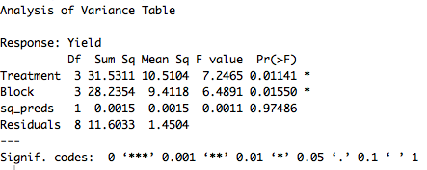
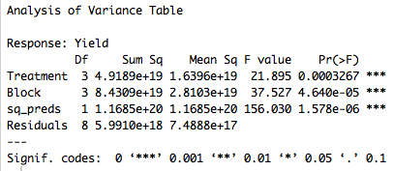
Tukey’s Test for Nonadditivity
Good (Wheat example) | Bad
p-value > 0.05
CONCLUSION: Additive model.
p-value ≤ 0.05
CONCLUSION: Nonadditivity in model.
Only look at p-value for ‘sq_preds’.

Slide 23
Wheat variety dataset:
Normally distributed errors
Equal variance
Additivity
All our assumption tests pass! Thus, the ANOVA for the field study is valid.

Slide 24
What if we failed 1 or more of the assumption tests?
Normally distributed errors
Equal variance
Additivity
All our assumption tests pass! Thus, the ANOVA for the field study is valid.

Slide 25
Transformations
Perform ANOVA on the dataset that best meets assumptions, which may not be the original scale (e.g. kg/ha, g, cm).
When data do not meet assumptions, one approach is to transform your data to see if the assumption tests improve.
Note: the transformation is applied to the dependent variable only (e.g. Yield)
WARNING: We do not transform data to get the results we want. We transform data so that the analysis and results are valid and correct.

Slide 26
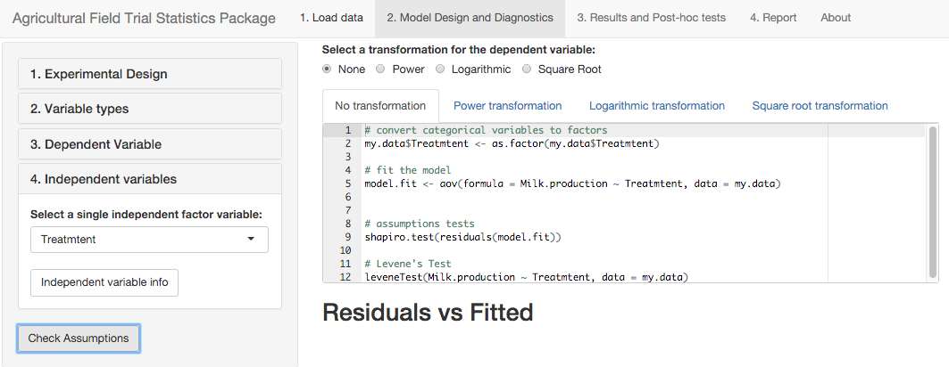
Transformations
If you decide to transform your dependent data (e.g. yield, milk production, plant height), try all 3 transformations using the app:
1. Power: (Dependent Data)ª
2. Log: log₁₀(Dependent Data)
3. Square Root: (Dependent Data)^{1/2}
Use the one that most improves the assumption tests.

Slide 27
You may need to edit your CSV file and re-load it to the app.
Before trying the log transformation
Not yet!
Are all measurements (dependent data) >0 and some values (or all) between 0 and 1?
If yes, multiply ALL measurements (dependent data only!) by a constant ‘x’ so that all values are ≥ 1.

Slide 28
You may need to edit your CSV file and re-load it to the app.
Before trying the log transformation
Not yet!
Or are any measurements ≤ 0?
If so, add a constant ‘X’ to all values (dependent data only!) so all measurements are ≥ 1.

Slide 29
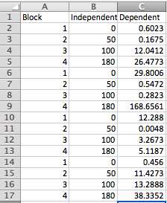
Which data do we need to change before the log transformation?
Example dataset

Slide 30
Warning: Before you change your data file, make sure to save it as a new file name (e.g. yieldx1000.xlsx) so you don’t lose your original data.
Example dataset

Slide 31
How would you change these data to get it ready for the log transformation?
Example dataset

Slide 32
Example dataset
We want all values ≥ 1.
Smallest value is 0.0048, so we must multiply by at least
X = 1000 to move decimal place 3 places to the right.

Slide 33
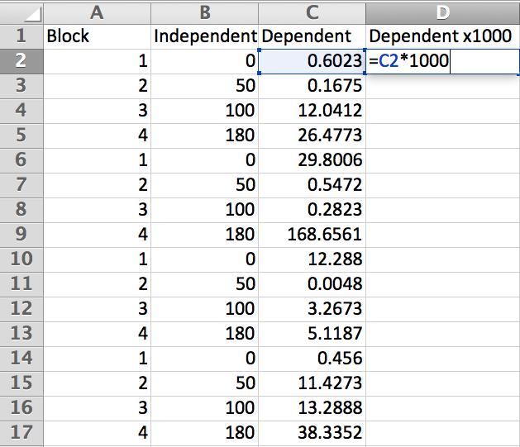
How to create column with all observations multiplied by 1000
Double-click and type a title that you will recognize

Slide 34
How to create column with all observations multiplied by 1000
Double-click in the cell and type:
=(cell ID)*X
(here, it’s: =C2*1000 )
Enter
Right-click in the cell you just entered and copy and paste into all the cells below.

Slide 35
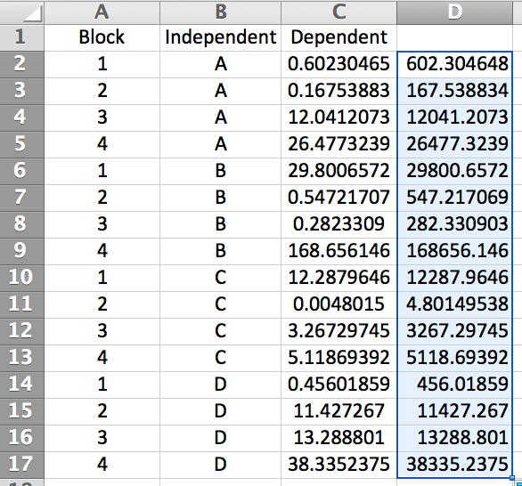
Are we ready to save and load this new file to the App?
Dependent x1000
Nope

Slide 36
Independent variable (Block)
Independent variable (Factor)
Dependent variable (Measurement)
Dependent x1000
Recall, your .csv file only contains the variables that will be used in the analysis (nothing extra).

Slide 37
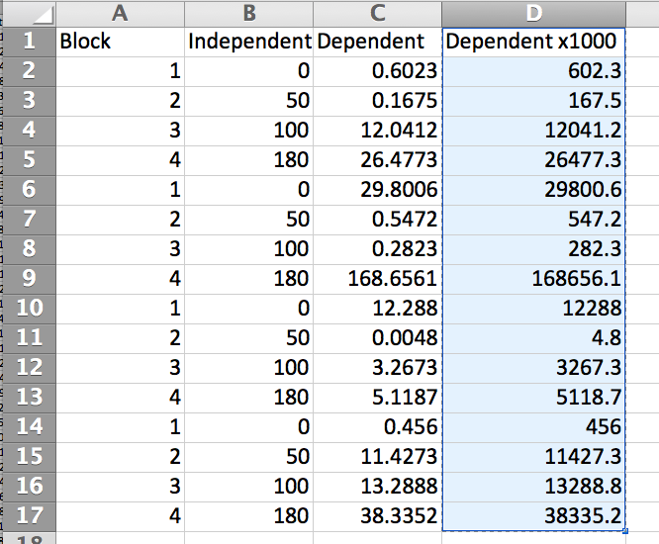
Select the new column, including the title.

Slide 38
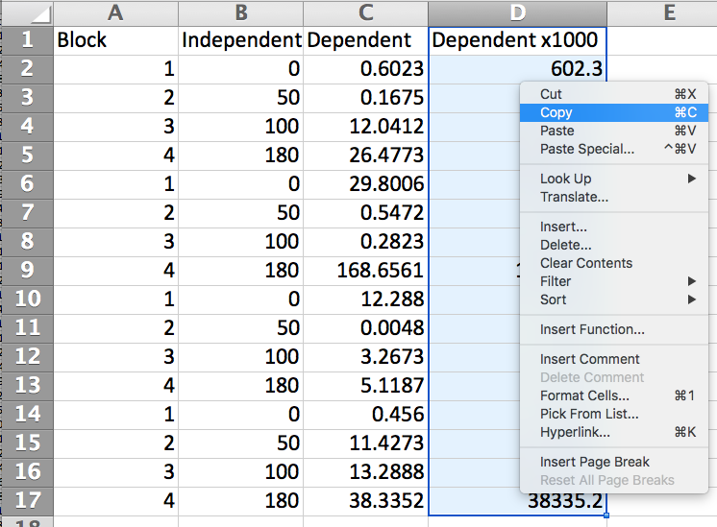
Right-click and choose ‘Copy’
Copy the data

Slide 39
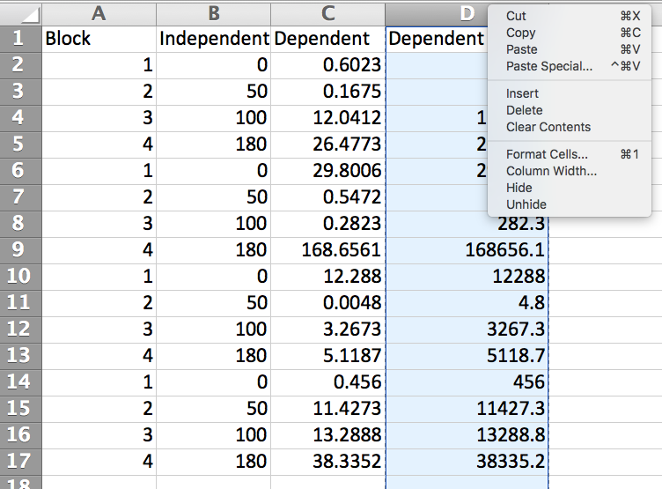
Rich-click at the top of the new column and choose ‘Paste Special’

Slide 40
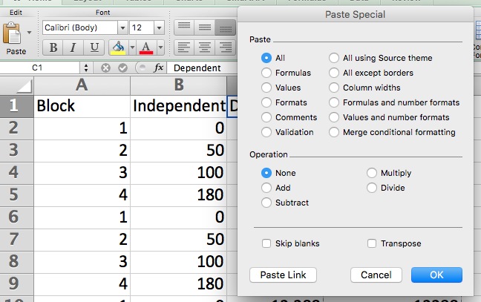
Click ‘Values’

Slide 41
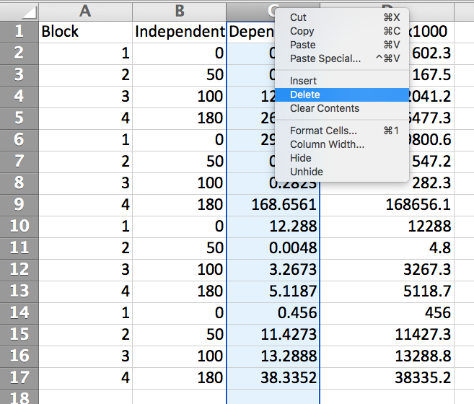
Now delete the original data column by right-clicking at top of column.
1
2
Click ‘Delete’.

Slide 42
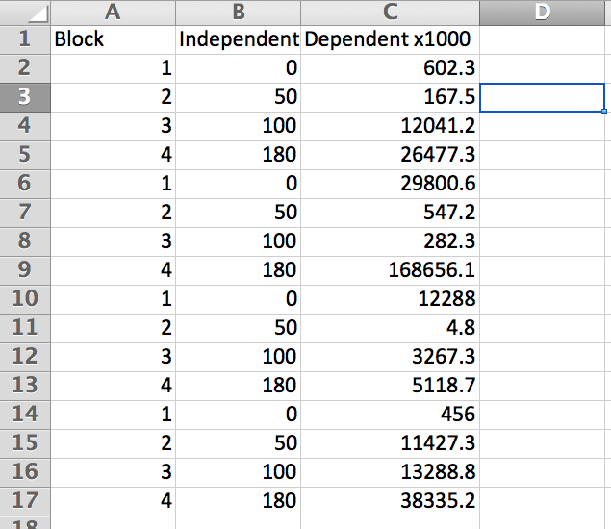
Now your data file is ready for a log transformation!
Save again as the new file name and load it again to the App.

Slide 43
Review: Before choosing log transformation
Are all observations (Y_{ij}) greater than 0 and some (or all) between 0 and 1?
If so, multiply your entire Y_{ij} dataset by a constant ‘X’ so that all values are ≥ 1.
Are any observations (Y_{ij}) ≤ 0?
If so, add a constant ‘X’ to entire Y_{ij} dataset so that all values are ≥ 1.
Only do one or the other.
If all your measurements are >1, no change is needed

Slide 44
Section 4 Learning Objectives
You should now have a basic understanding of:
The assumptions of ANOVA and transformations
What are the four assumptions of ANOVA?
How do you ensure your data meets the assumption of independent errors?
How do you use the app to check if your data meets the assumptions?
What can you do if your data fail an assumption test?
What types of transformations can you apply to your data using the app?
What range of values must your dataset be in before applying the log transformation?
What can you do if it is outside of that range?

Slide 45
Section 5 Learning Objectives
Have basic understanding of:
Factorial treatment structures
Linear model and ANOVA of factorial experiments
Interpreting ANOVA results and interactions
Mean Comparison Tests
Using the app to check assumptions and to transform data
Back-transformations and presenting results

Slide 46
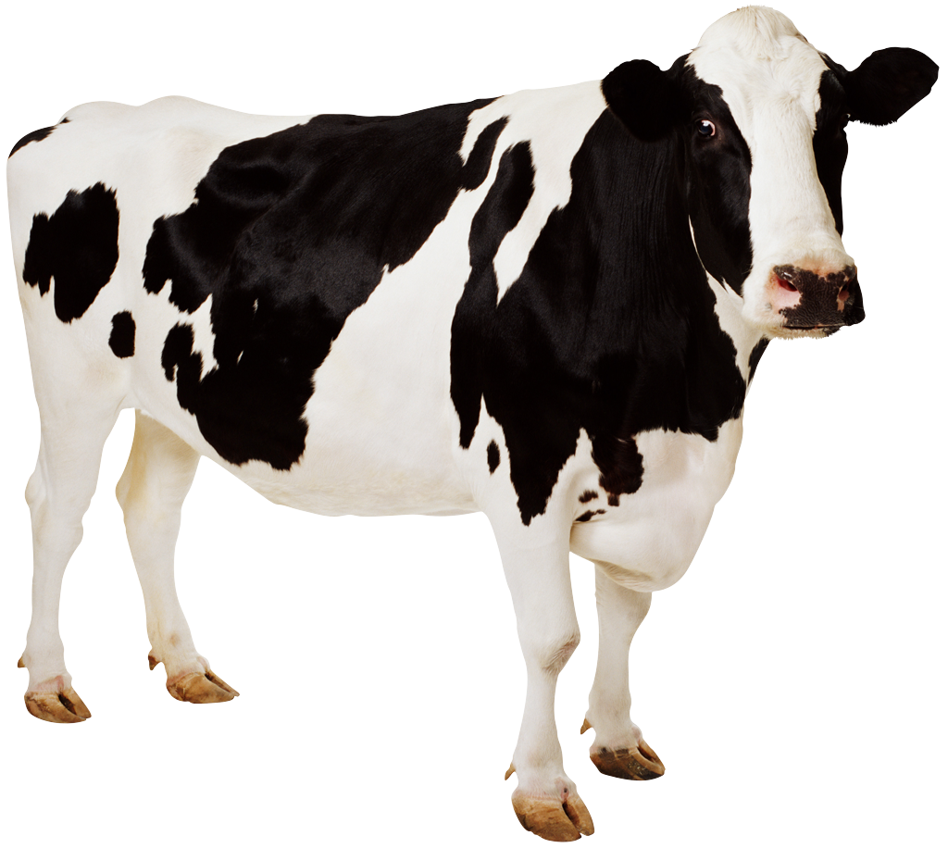
Observed milk production (kg)
Recall the CRD milking experiment. What was the independent variable(s)?
Replication | (1) Hand-milk 2x | (2) Hand-milk 3x | (3) Machine-milk 2x | (4) Machine-milk 3x
(1) | 8.6 | 11.2 | 9.6 | 11.5
(2) | 9.3 | 10.8 | 9.3 | 12.0
(3) | 9.1 | 11.7 | 9.0 | 11.8

Slide 47
Observed milk production (kg)
Recall the CRD milking experiment. What was the independent variable(s)?
Milking practice
Replication | (1) Hand-milk 2x | (2) Hand-milk 3x | (3) Machine-milk 2x | (4) Machine-milk 3x
(1) | 8.6 | 11.2 | 9.6 | 11.5
(2) | 9.3 | 10.8 | 9.3 | 12.0
(3) | 9.1 | 11.7 | 9.0 | 11.8

Slide 48
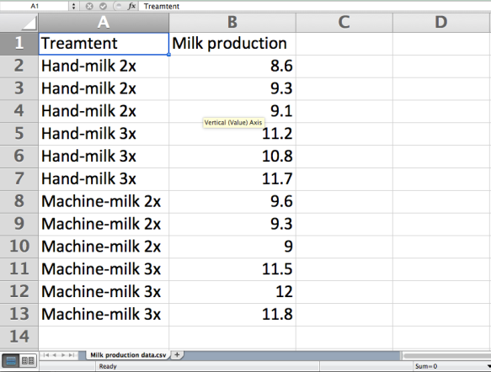
We analyzed the effect of this single factor (milking practice) on milk production.
Independent variable (Factor #1)
Dependent variable
Milking practice

Slide 49
But what about the individual effects of milking method (hand vs. machine), and milking frequency (twice vs. three times daily)?? Does the effect of one factor depend on the condition of the other factor?
Milking practice
Milking Method (factor A)
Method x Freq interaction
(A x B)
Milking Frequency
(factor B)

Slide 50
Get more information by analyzing the two factors individually as 2 independent variables!
Milking practice
Milking Method (factor A)
Method x Freq interaction
(A x B)
Milking Frequency
(factor B)

Slide 51
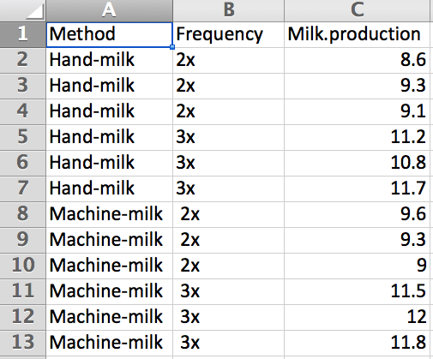
Get more information by analyzing the two factors individually as 2 independent variables!
Independent variable #1
Independent variable #2
Dependent variable
Note you need 3 separate columns for the app!

Slide 52
This is called a factorial treatment structure: Each level of Factor A must be combined with Factor B as a treatment in your experimental design.
Milking practice
Method (factor A)
Method x Freq interaction
(A x B)
Frequency
(factor B)
Hand-milk
Machine-milk
2x/day
3x/day
Hand-milk, 2x/day
Hand-milk, 3x/day
Machine-milk, 2x/day
Machine-milk, 3x/day

Slide 53
Let’s work on a new example of an experiment with a factorial treatment structure…

Slide 54
Research questions:
Does yield differ among clones (3 types)?

Slide 55

Research questions:
Does yield differ among clones (3 types)?
Does nitrogen fertilization affect yield (3 levels)?
Urea
Urea
Urea

Slide 56
Research questions:
Does yield differ among clones (3 types)?
Does nitrogen fertilization affect yield (3 levels)?
Does the effect of nitrogen on yield change from clone to clone?
Urea
Urea
Urea

Slide 57
Research questions:
Does yield differ among clones (3 types)?
Does nitrogen fertilization affect yield (3 levels)?
Does the effect of nitrogen on yield change from clone to clone?
Urea
Urea
Urea
In groups outline a field experiment to answer the questions above. Include:
Dependent variable?
Independent variable(s)?
Experimental design and treatment structure?
Field layout of experimental plots? (Assume 4 reps)

Slide 58
Dependent variable?
Independent variable(s)?
Experimental design and treatment structure?
Yield
Clone and Nitrogen
RCBD experiment with 2x2 factorial treatment structure (Clone, Nitrogen), 3 levels each, 4 blocks.
3 levels for each factor ➔
3 x 3 = 9 unique combinations
What does the layout of your field experiment look like?
 | Clone | Nitrogen
1 | c1 | n1
2 | c1 | n2
3 | c1 | n3
4 | c2 | n1
5 | c2 | n2
6 | c2 | n3
7 | c3 | n1
8 | c3 | n2
9 | c3 | n3
What is the experimental unit?
How many are there?
9 x 4 replications = 36

Slide 59
Dependent variable?
Independent variable(s)?
Experimental design and treatment structure?
Yield
Clone and Nitrogen
RCBD experiment with 2x2 factorial treatment structure (Clone, Nitrogen), 3 levels each, 4 blocks.
Plot = experimental unit
(n = 36)

Slide 60
Dependent variable?
Independent variable(s)?
Experimental design and treatment structure?
Yield
Clone and Nitrogen
RCBD experiment with 2x2 factorial treatment structure (Clone, Nitrogen), 3 levels each, 4 blocks.
Block 1 | Block 2 | Block 3 | Block 4
c3 n2
c1 n1
c3 n3
c2 n1
c1 n2
c1 n3
c3 n1
c2 n3
c2 n2
Randomly assign the 9 treatment combinations to each plot within a block

Slide 61
Dependent variable?
Independent variable(s)?
Experimental design and treatment structure?
Yield
Clone and Nitrogen
RCBD experiment with 2x2 factorial treatment structure (Clone, Nitrogen), 3 levels each, 4 blocks.
Repeat randomization of treatments for each block
Block 1 | Block 2 | Block 3 | Block 4
c3 n2 | c1 n2 | c3 n1 | c2 n3
c1 n1 | c3 n1 | c2 n3 | c1 n3
c3 n3 | c3 n2 | c1 n3 | c2 n1
c2 n1 | c1 n1 | c3 n2 | c3 n2
c1 n2 | c2 n2 | c2 n1 | c3 n1
c1 n3 | c2 n3 | c1 n1 | c1 n1
c3 n1 | c1 n3 | c1 n2 | c2 n2
c2 n3 | c1 n1 | c2 n2 | c3 n3
c2 n2 | c2 n1 | c1 n1 | c1 n2

Slide 62
Dependent variable?
Independent variable(s)?
Experimental design and treatment structure?
Yield
Clone and Nitrogen
RCBD experiment with 2x2 factorial treatment structure (Clone, Nitrogen), 3 levels each, 4 blocks.
Layout of field experiment
Block 1 | Block 2 | Block 3 | Block 4
c3 n2 | c1 n2 | c3 n1 | c2 n3
c1 n1 | c3 n1 | c2 n3 | c1 n3
c3 n3 | c3 n2 | c1 n3 | c2 n1
c2 n1 | c1 n1 | c3 n2 | c3 n2
c1 n2 | c2 n2 | c2 n1 | c3 n1
c1 n3 | c2 n3 | c1 n1 | c1 n1
c3 n1 | c1 n3 | c1 n2 | c2 n2
c2 n3 | c1 n1 | c2 n2 | c3 n3
c2 n2 | c2 n1 | c1 n1 | c1 n2
Your yield data are ready

Slide 63
Let’s use the app to analyze the clone x irrigation dataset!
Load ‘rcbd_two_var.csv’ to the app
This time, we’ll do all the data analysis steps in the correct order:
Check assumptions, and transform data if necessary
Check ANOVA results, and perform Tukey’s Mean Comparison Test

Slide 64
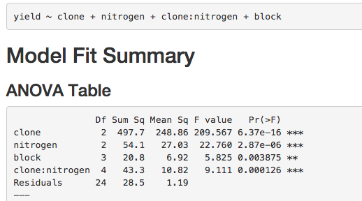
Here are the results, does everything look okay?

Slide 65
The model looks good ➔ all variables in correct combinations
Notes:
Wait until everyone had loaded the file…

Slide 66
But we don’t know yet if the ANOVA is valid! We must check assumption tests first and verify everything looks good or transform the data!
Notes:
Wait until everyone had loaded the file…

Slide 67
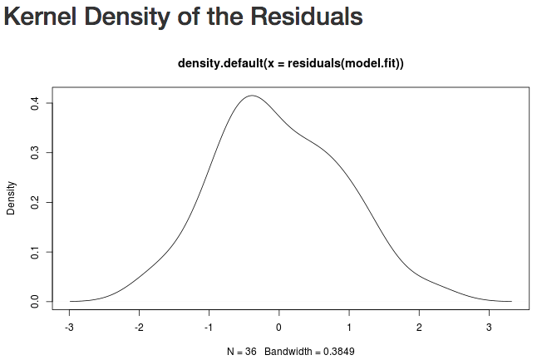
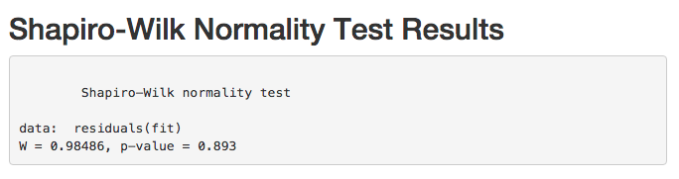
Normality
Equal
variance
Additive
model

Slide 68
Normality
Equal
variance
Additive
model
P-value > 0.05 ➔ GOOD!

Slide 69
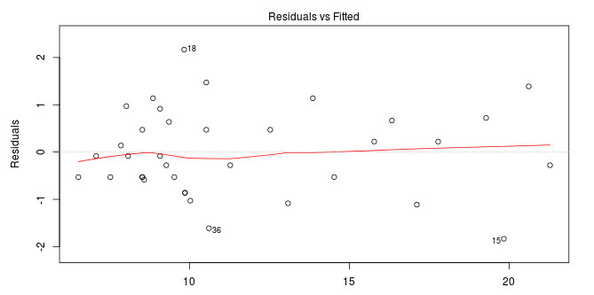
Fitted
Yield ~ Clone + Nitrogen + Clone:Nitrogen + Block
Normality
Equal
variance
Additive
model
Residuals vs Fitted
Alert! Residuals increase with fitted values.
Residuals
Does the plot display any trend that may be a problem?
Fitted

Slide 70
Fitted
Yield ~ Clone + Nitrogen + Clone:Nitrogen + Block
Normality
Equal
variance
Additive
model
Residuals vs Fitted
Alert! Residuals increase with fitted values.
Residuals
Fitted
Let’s check the box plots to see how differences within treatments (error) compares among clone and nitrogen treatment levels

Slide 71
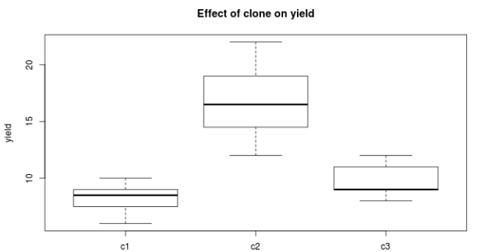
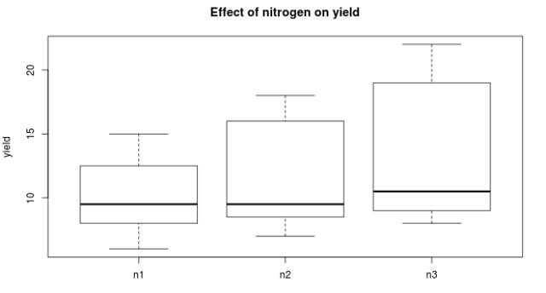
Effect of clone on yield
Some treatment levels appear to have unequal differences within treatment levels
Normality
Equal
variance
Additive
model
Yield
c1 c2 c3
Effect of nitrogen on yield
What do these box plots tell you about variance across treatment levels?
Yield
N1 N2 N3

Slide 72
Effect of clone on yield
Normality
Equal
variance
Additive
model
Yield
To confirm, let’s check Levene’s tests for (1) clone and (2) nitrogen
c1 c2 c3
Effect of nitrogen on yield
Yield
N1 N2 N3

Slide 73
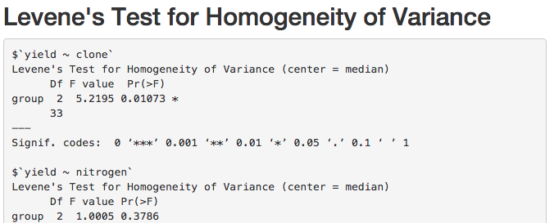
Normality
Equal
variance
Additive
model
Levene’s Test for Homogeneity of Variance
Does everything look OK?

Slide 74
Normality
Equal
variance
Additive
model
Levene’s Test for Homogeneity of Variance
P-value < 0.05 ➔ Unequal variance
P-value ≥ 0.05 ➔ equal variance

Slide 75
Normality
Equal
variance
Additive
model
Levene’s Test for Homogeneity of Variance
P-value < 0.05 ➔ Unequal variance
P-value ≥ 0.05 ➔ equal variance
Let’s check the last test, Tukey’s Test for Nonadditivity.

Slide 76
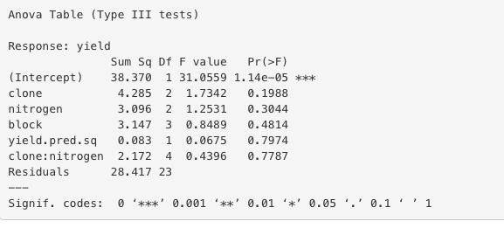
Tukey’s Test for Nonadditivity
Attention: Refer only to the ‘yield.pred.sq’ row in this table, ignore all other rows.
Normality
Equal
variance
Additive
model
Does everything look OK?

Slide 77
Tukey’s Test for Nonadditivity
Attention: Refer only to the ‘yield.pred.sq’ row in this table, ignore all other rows.
Normality
Equal
variance
Additive
model
P-value > 0.05
OK!
Does everything look OK?

Slide 78
What’s the next step?
Normality
Equal
variance
Additive
model

Slide 79
Normality
Equal
variance
Additive
model
We need to transform the yield data to address unequal variance.
Try all transformations, but we will just go over Log and Power.

Slide 80
First the power transformation….

Slide 81
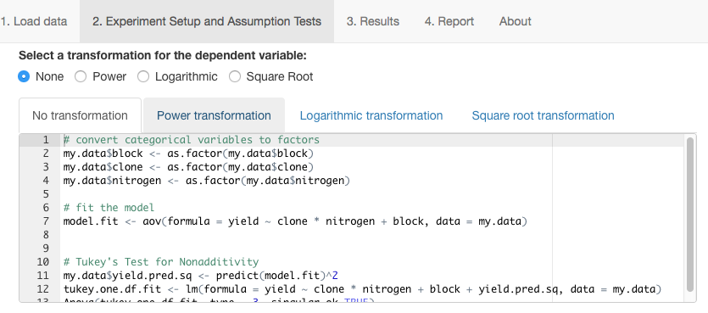
Click Power transformation.

Slide 82
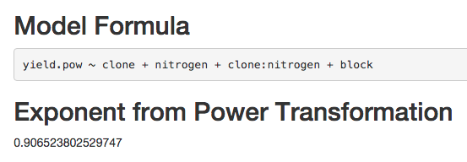
Note the exponent used in the power transformation
What does this mean?
Each measurement was raised to 0.9065: (Yield value)^{0.9065}
Let’s check the Assumption Tests to see if they improved..

Slide 83

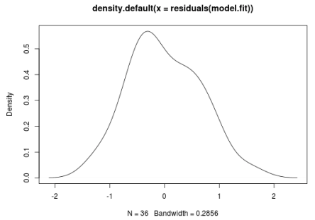
Assumption of normality
Original data | Power-transformed
Shapiro-Wilk Test
Data: residuals(fit)
W = 0.98486, | p-value = 0.893
Shapiro-Wilk Test
Data: residuals(fit)
W = 0.98225, | p-value = 0.8185
Recall, p>0.05 ➔ normally distributed residuals
Also OK
Density
Density

Slide 84

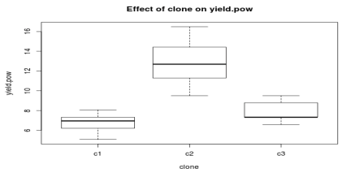
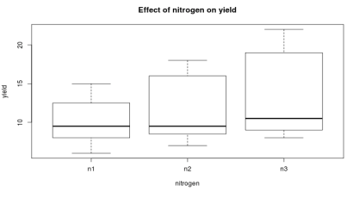
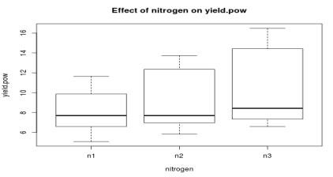
Assumption of equal variance
Original data | Power-transformed
Levene’s Test
yield ~ clone
 | Df | F value | Pr(>F)
group | 2 | 5.2195 | 0.01073
Levene’s Test
yield.pow ~ clone
 | Df | F value | Pr(>F)
group | 2 | 46163 | 0.01707
Recall, p<0.05 ➔ unequal variance among clone levels
Not much better!
yield ~ nitrogen
 | Df | F value | Pr(>F)
group | 2 | 1.0005 | 0.3786
yield.pow ~ nitrogen
 | Df | F value | Pr(>F)
group | 2 | 0.9421 | 0.4
Effect of clone
on yield
Effect of clone
on yield.pow
10 15 20
yield.pow
yield
6 10 14
c1 c2 c3
c1 c2 c3
Effect of nitrogen on yield
Effect of nitrogen on yield.pow
10 15 20
yield
yield.pow
6 10 14
n1 n2 n3
n1 n2 n3

Slide 85
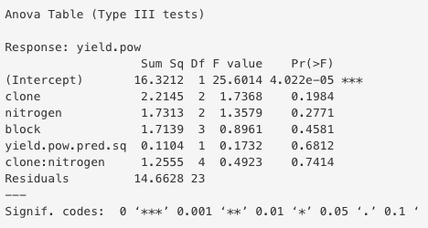
Assumption of additivity
Original data | Power-transformed
Tukey’s Test for Nonadditivity
Attention: Refer only to the ‘yield.pred.sq’ row in this table, ignore all other rows.
Tukey’s Test for Nonadditivity
Attention: Refer only to the ‘yield.pred.sq’ row in this table, ignore all other rows.
Recall, p-value > 0.05 ➔ Good!
Still good, p>0.05

Slide 86
Now let’s try the logarithmic (log) transformation…

Slide 87
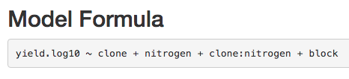
Note the new model formula with the dependent variable: yield.log10

Slide 88
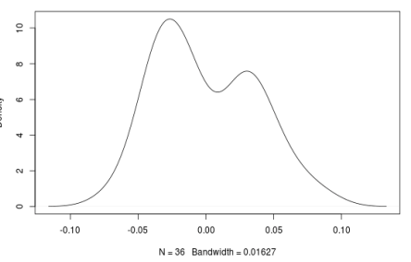
Assumption of normality
Original data | log-transformed
Shapiro-Wilk Test
Data: residuals(fit)
W = 0.98486, | p-value = 0.893
Shapiro-Wilk Test
Data: residuals(fit)
W = 0.94738, | p-value = 0.08646
Recall, p>0.05 ➔ OK
Also OK, but worse than original
Density
Density

Slide 89
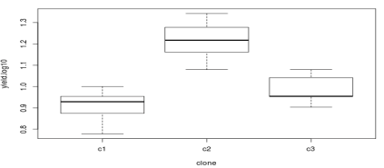
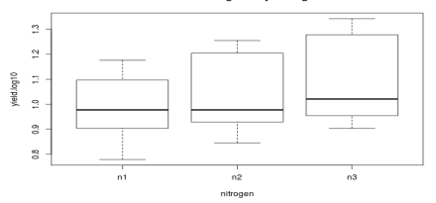
Assumption of equal variance
Original data | log-transformed
Levene’s Test
yield ~ clone
 | Df | F value | Pr(>F)
group | 2 | 5.2195 | 0.01073
Levene’s Test
yield.log10 ~ clone
 | Df | F value | Pr(>F)
group | 2 | 0.4815 | 0.6221
Improvement!
p>0.05 ➔ OK!
Recall, p<0.05 ➔ Bad (unequal variance among clone levels)
yield ~ nitrogen
 | Df | F value | Pr(>F)
group | 2 | 1.0005 | 0.3786
yield.log10 ~ nitrogen
 | Df | F value | Pr(>F)
group | 2 | 0.3762 | 0.6894
Also OK!
Effect of clone
on yield
Effect of clone on yield.log10
10 15 20
yield.log10
yield
0.8 1.0 1.2
c1 c2 c3
c1 c2 c3
Effect of nitrogen on yield
Effect of nitrogen on yield.log10
10 15 20
yield
Yyeld.log10
6 10 14
n1 n2 n3
n1 n2 n3

Slide 90
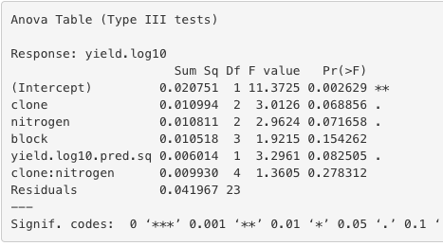
Assumption of additivity
Original data | log-transformed
Tukey’s Test for Nonadditivity
Attention: Refer only to the ‘yield.pred.sq’ row in this table, ignore all other rows.
Tukey’s Test for Nonadditivity
Attention: Refer only to the ‘yield.log10.pred.sq’ row in this table, ignore all other rows.
Recall, p-value>0.05 ➔ Good
Worse, but still OK.

Slide 91
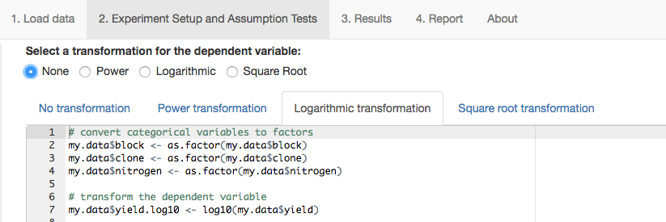
Overall, the log transformation improved the assumption tests the most.
Thus, we will choose the log-transformed data for the final analysis.
Make sure to also click ‘Logarithmic’!!!!

Slide 92
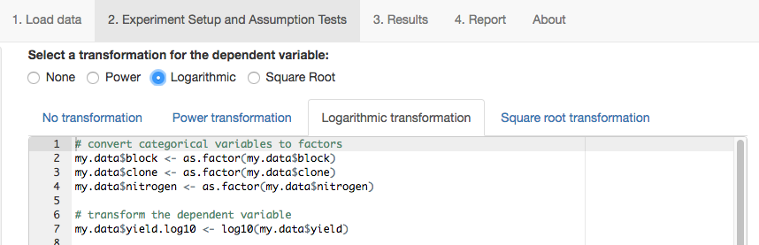
Overall, the log transformation improved the assumption tests the most.
Thus, we will choose the log-transformed data for the final analysis.
Make sure to also click ‘Logarithmic’!!!!

Slide 93
What do we do if our data are still failing the Levene’s test after transformations?!

Slide 94
If your data transformation does not improve your Levene’s test, you may want to use a Weighted Least Squares approach, but this is not covered in the course or available with the App.

Slide 95
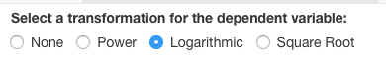
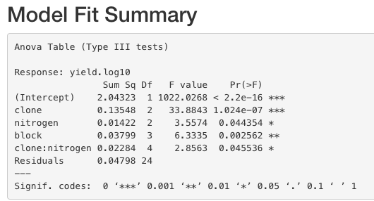
Let’s check the ANOVA results for log-transformed yield
First, make sure ‘log10’ is in the dependent variable name – if not, go back to Experimental setup & Assumption tests and make sure ‘Logarithmic’ is selected for the transformation.

Slide 96
Let’s check the ANOVA results for log-transformed yield
Does clone have an effect on yield?

Slide 97
Let’s check the ANOVA results for log-transformed yield
The effect of clone on yield depends on the nitrogen level due to the significant interaction.
Notes:
We know this because the clone by nitrogen interaction is significant. Because this is log transformed data: Does the proportional change in yield due to nitrogen vary from clone to clone? If it was original data: Does the proportional change in yield due to nitrogen vary from clone to clone?

Slide 98
Output for log-transformed yield
We know this because there is a significant interaction.
Interaction = the effect of one factor depends on the level of the other factor.
Notes:
We know this because the clone by nitrogen interaction is significant.

Slide 99
Output for log-transformed yield
In a 2-factor factorial, there are 3 terms to look at in ANOVA table:
Factor A (clone)
Factor B (nitrogen)
AxB (clone:nitrogen)
If interaction is significant (p<0.05), the Mean Comparison Test is performed on all treatment level combinations. For example, we can’t say which Nitrogen level produced the highest yield unless we refer to the Clone as well.

Slide 100
Interaction plots
No Interaction | Interaction
B1
B1
B2
B2
Yield
Yield
Intersecting or non-parallel lines ➔ effect of A on Y is dependent
on B
Parallel lines ➔ effect of A on Y is independent of B
A1
A2
A1
A2
B1
B2
Yield
Yield
B1
B2
A1
A2
A1
A2

Slide 101
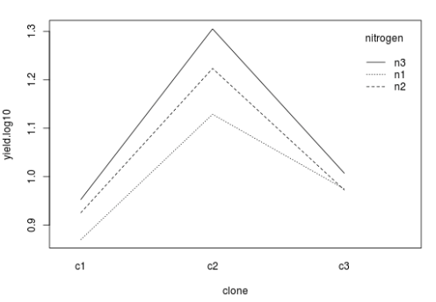
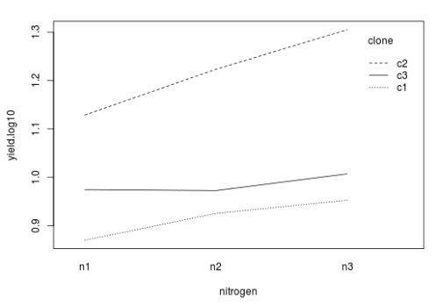
Interaction plots from log-transformed yield variable
What do these plots say about the interaction effect of nitrogen and clone on yield?

Slide 102
Interaction plots from log-transformed yield variable
The effect of nitrogen rate differs for each clone, and the strongest response was observed in clone 2.

Slide 103
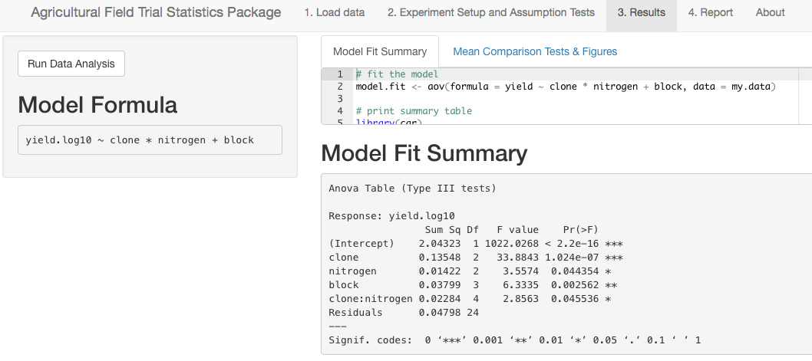
Click Mean Comparison Tests & Figures

Slide 104
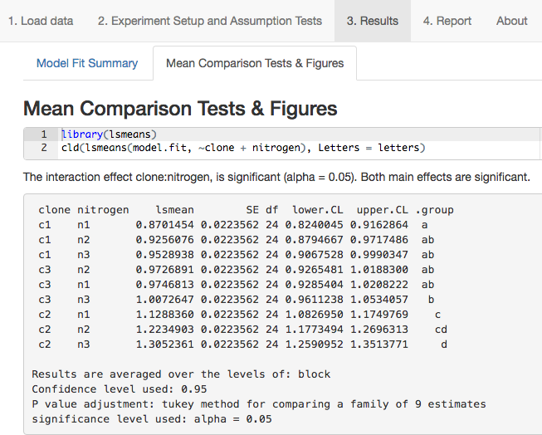
The App chooses the correct mean comparison test and figures based on the ANOVA.

Slide 105
NOTE: Output is in log-scale due to the transformation. We will learn how to present results in the original units in the next section.

Slide 106
Key output includes:
Least square means

Slide 107
Key output includes:
Least square means
Standard error

Slide 108
Key output includes:
Least square means
Standard deviation
95% confidence interval

Slide 109
Key output includes:
Least square means
Standard deviation
95% confidence interval
Tukey’s Mean Comparison Groupings

Slide 110
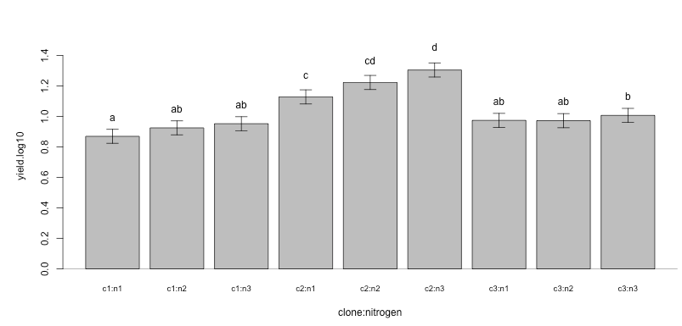
Key output includes:
Least square means
Standard deviation
95% confidence interval
Tukey’s Mean Comparison Groupings
Bar plot

Slide 111
Key output includes:
Least square means
Standard deviation
95% confidence interval
Tukey’s Mean Comparison Groupings
Bar plot
Note that the y-axis is in the log scale.

Slide 112
How does yield of clone 2 compare to yield of clone 3?
Notes:
Yield of clone 2 is greater than clone 3 *across all N levels tested*.

Slide 113
Does nitrogen affect yield of all clones?

Slide 114
Next, a quick review…

Slide 115
Check assumptions: Do the data meet all ANOVA assumptions?
YES
NO
Run ANOVA: Is there a significant FactorA x FactorB interaction?
Transform data
YES
NO
Look at simple effects (all factor combinations) using Tukey test: Which levels don’t share the same letter?
Is there a significant effect of FactorA or FactorB?
YES
Conclusion: there is a significant effect of factor(A or B) at p<0.05.
NO
Conclusion: These levels differ significantly at p<0.05
Conclusion: no sufficient evidence to support that there is an effect of factor(A or B) on Y at p<0.05.
Look at main effects of significant factors using Tukey test: Which levels don’t share the same letter?
Conclusion: These levels differ significantly at p<0.05

Slide 116
Next, a quick pop quiz…

Slide 117
(1) If the p-value = 0.03 for the Shapiro-Wilk test, can we proceed with the ANOVA?
Why or why not?
Example dataset
Independent variable: N fertilizer rate (kg nitrogen ha⁻¹) | Block | Dependent variable: Yield (kg grain ha⁻¹)
0 | 1 | 7.1
50 | 1 | 9
100 | 1 | 9.5
0 | 2 | 6.2
50 | 2 | 8.8
100 | 2 | 9.2

Slide 118
(2) If the app determines the exponent a for power transformation of the dataset below:
a = 0.2. What are the power-transformed values?
N fertilizer rate (kg nitrogen ha⁻¹) | Block | Yield (kg grain ha⁻¹) | Power-transformed Yield
0 | 1 | 7.1
50 | 1 | 9
100 | 1 | 9.5
0 | 2 | 6.2
50 | 2 | 8.8
100 | 2 | 9.2

Slide 119
(2) If the app determines the exponent a for power transformation of the dataset below:
a = 0.2. What are the power-transformed values?
N fertilizer rate (kg nitrogen ha⁻¹) | Block | Yield (kg grain ha⁻¹) | Power- transformed Yield: (Y_{ij})^{0.2}
0 | 1 | 7.1 | (7.1)^{0.2} = 1.48
50 | 1 | 9 | 1.55
100 | 1 | 9.5 | 1.57
0 | 2 | 6.2 | 1.44
50 | 2 | 8.8 | 1.54
100 | 2 | 9.2 | 1.56

Slide 120
(3) What are the units of the power-transformed data?
N fertilizer rate (kg nitrogen ha⁻¹) | Block | Yield (kg grain ha⁻¹) | Power-transformed Yield
0 | 1 | 7.1 | 1.48
50 | 1 | 9 | 1.55
100 | 1 | 9.5 | 1.57
0 | 2 | 6.2 | 1.44
50 | 2 | 8.8 | 1.54
100 | 2 | 9.2 | 1.56

Slide 121
(3) What are the units of the power-transformed data?
N fertilizer rate (kg nitrogen ha⁻¹) | Block | Yield (kg grain ha⁻¹) | Power-transformed Yield (kg grain ha⁻¹)^{0.2}
0 | 1 | 7.1 | 1.48
50 | 1 | 9 | 1.55
100 | 1 | 9.5 | 1.57
0 | 2 | 6.2 | 1.44
50 | 2 | 8.8 | 1.54
100 | 2 | 9.2 | 1.56

Slide 122
Presenting results from analyses of transformed data
When your data has been transformed, the units change too!
Ex. Yield (ton/ha)
Tests of significance (e.g. F tests in ANOVA table) and mean comparison tests are performed on the transformed data.
However, it’s common practice to present results using the original units. This can be done in two ways: (1) present original means, or (2) back-transform means
Original units
Log transformation
Log-transformed units
Yield (log(ton/ha))
IMPORTANT: When reporting results using original units, make sure to state that the statistical analyses were performed on (power- or log-) transformed data.

Slide 123
Example: Here’s the app output for the Tukey test, how would you formally present the results?
Fertilizer N Treatment (kg N ha⁻¹) | Power-Transformed Mean Yield (kg grain ha⁻¹)^{0.2} | Tukey Groupings of Power-Transformed Means
0 | 1.46 | a
50 | 1.55 | b
100 | 1.57 | b
Notes:
Present results in original units.

Slide 124
Two ways to present results in original units:
1. Back-transformation
a. Convert power-transformed mean yield (Y_{trans}) back to the original units (kg ha⁻¹) by:
b. Convert log-transformed mean yield (Y_{trans}) back to the original units (kg ha⁻¹) by:
If data were multiplied by constant ‘x’ before doing the log-transformation, first divide each transformed mean by x:
If data were added to a constant ‘x’ before doing the log-transformation, first subtract each transformed mean by x:
Or calculate means of original dataset

Slide 125
Example: If this were your post-hoc output for the Tukey test, how would you formally present the results?
Fertilizer N Treatment (kg N ha⁻¹) | Power-Transformed Mean Yield (kg grain ha⁻¹)^{0.2} | Tukey Groupings of Power-Transformed Means
0 | 1.46 | a
50 | 1.55 | b
100 | 1.57 | b
Notes:
Present results in original units.

Slide 126
Option 1:
Convert power-transformed mean yield (kg ha⁻¹)ª back to the original units (kg ha⁻¹) by: (Y_{i,trans})^{(1/a)} = Y_{i}
Note: these are weighted means
Note: these are weighted means ≠ original means
Fertilizer N Treatment (kg N ha⁻¹) | Power-transformed Mean Yield (kg grain ha⁻¹)^{0.2} | Back-Transformed Mean Yield (kg ha⁻¹) | Tukey Groupings of Power-Transformed Means
0 | 1.46 | (1.46)^{1/a} | a
50 | 1.55 | (1.55)^{1/a} | b
100 | 1.57 | (1.57)^{1/a} | b

Slide 127
Option 1:
Convert power-transformed mean yield (kg ha⁻¹)ª back to the original units (kg ha⁻¹) by: (Y_{i,trans})^{(1/a)} = Y_{i}
Fertilizer N Treatment (kg N ha⁻¹) | Power-transformed Mean Yield (kg grain ha⁻¹)^{0.2} | Back-Transformed Mean Yield (kg ha⁻¹) | Tukey Groupings of Power-Transformed Means
0 | 1.46 | (1.46)^{1/0.2} | a
50 | 1.55 | (1.55)^{1/0.2} | b
100 | 1.57 | (1.57)^{1/0.2} | b

Slide 128
Option 1:
Convert power-transformed mean yield (kg ha⁻¹)ª back to the original units (kg ha⁻¹) by: (Y_{i,trans})^{(1/a)} = Y_{i}
Fertilizer N Treatment (kg N ha⁻¹) | Power-transformed Mean Yield (kg grain ha⁻¹)^{0.2} | Back-Transformed Mean Yield (kg ha⁻¹) | Tukey Groupings of Power-Transformed Means
0 | 1.46 | 6.63 | a
50 | 1.55 | 8.80 | b
100 | 1.57 | 9.39 | b

Slide 129
A formatted table may look something like this:
Table 1. Yield response to N fertilizer additions.
Fertilizer N Rate (kg N ha⁻¹) | Mean Yield¹ (kg ha⁻¹)
0 | 6.63a²
50 | 8.80b
100 | 9.39b
¹Least square means after transformation back to the original measurement scale. ²Mean yields not sharing the same letter are significantly different at p<0.05 based on Tukey’s mean comparison applied to power-transformed data.

Slide 130
Option 1:
Convert power-transformed mean yield (Y_{trans}) back to the original units (kg ha⁻¹) by:
Fertilizer N Treatment (kg N ha⁻¹) | Power-transformed Mean Yield (kg ha⁻¹)^{0.2} | Back-Transformed Mean Yield (kg ha⁻¹) | Tukey Groupings Of Power-Transformed Means
0 | 1.46 | 6.63 | a
50 | 1.55 | 8.80 | b
100 | 1.57 | 9.39 | b

Slide 131
Option 1:
Convert power-transformed mean yield (Y_{trans}) back to the original units (kg ha⁻¹) by:
Option 2:
Calculate means of original dataset.
Fertilizer N Treatment (kg N ha⁻¹) | Power-transformed Mean Yield (kg ha⁻¹)^{0.2} | Back-Transformed Mean Yield (kg ha⁻¹) | Tukey Groupings Of Power-Transformed Means
0 | 1.46 | 6.63 | a
50 | 1.55 | 8.80 | b
100 | 1.57 | 9.39 | b

Slide 132
Option 1:
Convert power-transformed mean yield (Y_{trans}) back to the original units (kg ha⁻¹) by:
Option 2:
Calculate means of original dataset.
Fertilizer N rate (kg N ha⁻¹) | Block | Yield (kg ha⁻¹)
0 | 1 | 7.1
50 | 1 | 9
100 | 1 | 9.5
0 | 2 | 6.2
50 | 2 | 8.8
100 | 2 | 9.2
Original dataset
Fertilizer N Treatment (kg N ha⁻¹) | Back-Transformed Mean Yield (kg ha⁻¹) | Mean Yield (kg ha⁻¹) | Tukey Groupings of Power-Transformed Means
0 | 6.63 |  | a
50 | 8.80 |  | b
100 | 9.39 |  | b

Slide 133
Option 1:
Convert power-transformed mean yield (Y_{trans}) back to the original units (kg ha⁻¹) by:
Option 2:
Calculate means of original dataset.
Fertilizer N rate (kg N ha⁻¹) | Block | Yield (kg ha⁻¹)
0 | 1 | 7.1
50 | 1 | 9
100 | 1 | 9.5
0 | 2 | 6.2
50 | 2 | 8.8
100 | 2 | 9.2
Fertilizer N Treatment (kg N ha⁻¹) | Back-Transformed Mean Yield (kg ha⁻¹) | Mean Yield (kg ha⁻¹) | Tukey Groupings Of Power-Transformed Means
0 | 6.63 | (7.1+6.2)/2 | a
50 | 8.80 |  | b
100 | 9.39 |  | b

Slide 134
Option 1:
Convert power-transformed mean yield (Y_{trans}) back to the original units (kg ha⁻¹) by:
Option 2:
Calculate means of original dataset.
Fertilizer N rate (kg N ha⁻¹) | Block | Yield (kg ha⁻¹)
0 | 1 | 7.1
50 | 1 | 9
100 | 1 | 9.5
0 | 2 | 6.2
50 | 2 | 8.8
100 | 2 | 9.2
Fertilizer N Treatment (kg N ha⁻¹) | Back-Transformed Mean Yield (kg ha⁻¹) | Mean Yield (kg ha⁻¹) | Tukey Groupings of Power-Transformed Means
0 | 6.63 | 6.65 | a
50 | 8.80 | 8.90 | b
100 | 9.39 | 9.35 | b

Slide 135
A formatted table may look something like this:
Table 1. Yield response to N fertilizer additions.
Fertilizer N Rate (kg N ha⁻¹) | Mean Yield (kg ha⁻¹)
0 | 6.7a¹
50 | 8.9b
100 | 9.4b
¹Mean yields not sharing the same letter are significantly different at p<0.05 based on Tukey’s mean comparison test applied to power transformed data.

Slide 136
Section 6 Learning Objectives
Have basic understanding of:
Split-plot experimental designs
What are they, and why are they used?

Slide 137
Section 6 Learning Objectives
Research question: In a rice system, does the type of irrigation method (mid-season drain, no drain) and rate of nitrogen fertilizer application (0, 80, 140 kg N ha⁻¹) affect methane emissions?
If only 2 irrigation methods could be established per field due to practical constraints (e.g. risk of water seepage), how could you design an experiment to investigate these research questions if you had 3 fields?
Field 1
Field 2
Field 3
Notes:
Changing irrigation methods within a single field can be challenging for several reasons (e.g. risk of seepage into adjacent treatments).

Slide 138
I. Factorial experiment in CRD = ONE stage randomization.
A1-B2 | A2-B3 | A2-B3 | A3-B2 | A1-B1 | A3-B2 | A1-B2 | A2-B3 | A3-B1
A1-B2 | A3-B1 | A1-B1 | A1-B2 | A1-B2 | A1-B1 | A3-B1 | A3-B2 | A1-B2

Slide 139
I. Factorial experiment in CRD = ONE stage randomization.
A1-B1 | A2-B1 | A2-B2 | A3-B2 | A1-B2 | A3-B1 | A2-B1 | A2-B2 | A2-B2
A1-B2 | A3-B1 | A1-B1 | A1-B2 | A3-B1 | A1-B1 | A3-B2 | A2-B1 | A3-B2

Slide 140
I. Factorial experiment in CRD = ONE stage randomization.
A1-B1 | A2-B1 | A2-B2 | A3-B2 | A1-B2 | A3-B1 | A2-B1 | A2-B2 | A2-B2
A1-B2 | A3-B1 | A1-B1 | A1-B2 | A3-B1 | A1-B1 | A3-B2 | A2-B1 | A3-B2
II. Factorial experiment in RCBD = ONE stage randomization per block.
A1-B2 | A3-B2 | A3-B1 |  | A2-B2 | A2-B1 | A3-B2 |  | A3-B2 | A3-B1 | A1-B1
A2-B2 | A2-B1 | A1-B1 |  | A3-B1 | A1-B2 | A1-B1 |  | A2-B1 | A2-B2 | A1-B2

Slide 141
I. Factorial experiment in CRD = ONE stage randomization.
A1-B1 | A2-B1 | A2-B2 | A3-B2 | A1-B2 | A3-B1 | A2-B1 | A2-B2 | A2-B2
A1-B2 | A3-B1 | A1-B1 | A1-B2 | A3-B1 | A1-B1 | A3-B2 | A2-B1 | A3-B2
II. Factorial experiment in RCBD = ONE stage randomization per block.
A1-B2 | A3-B2 | A3-B1 |  | A2-B2 | A2-B1 | A3-B2 |  | A3-B2 | A3-B1 | A1-B1
A2-B2 | A2-B1 | A1-B1 |  | A3-B1 | A1-B2 | A1-B1 |  | A2-B1 | A2-B2 | A1-B2

Slide 142
I. Factorial experiment in CRD = ONE stage randomization.
A1-B1 | A2-B1 | A2-B2 | A3-B2 | A1-B2 | A3-B1 | A2-B1 | A2-B2 | A2-B2
A1-B2 | A3-B1 | A1-B1 | A1-B2 | A3-B1 | A1-B1 | A3-B2 | A2-B1 | A3-B2
II. Factorial experiment in RCBD = ONE stage randomization per block.
A1-B2 | A3-B2 | A3-B1 |  | A2-B2 | A2-B1 | A3-B2 |  | A3-B2 | A3-B1 | A1-B1
A2-B2 | A2-B1 | A1-B1 |  | A3-B1 | A1-B2 | A1-B1 |  | A2-B1 | A2-B2 | A1-B2

Slide 143
I. Factorial experiment in CRD = ONE stage randomization.
A1-B1 | A2-B1 | A2-B2 | A3-B2 | A1-B2 | A3-B1 | A2-B1 | A2-B2 | A2-B2
A1-B2 | A3-B1 | A1-B1 | A1-B2 | A3-B1 | A1-B1 | A3-B2 | A2-B1 | A3-B2
II. Factorial experiment in RCBD = ONE stage randomization per block.
A1-B2 | A3-B2 | A3-B1 |  | A2-B2 | A2-B1 | A3-B2 |  | A3-B2 | A1-B1 | A3-B1
A2-B2 | A2-B1 | A1-B1 |  | A3-B1 | A1-B2 | A1-B1 |  | A2-B1 | A2-B2 | A1-B2

Slide 144
I. Factorial experiment in CRD = ONE stage randomization.
A1-B1 | A2-B1 | A2-B2 | A3-B2 | A1-B2 | A3-B1 | A2-B1 | A2-B2 | A2-B2
A1-B2 | A3-B1 | A1-B1 | A1-B2 | A3-B1 | A1-B1 | A3-B2 | A2-B1 | A3-B2
II. Factorial experiment in RCBD = ONE stage randomization per block.
A1-B2 | A3-B2 | A3-B1 |  | A2-B2 | A2-B1 | A3-B2 |  | A3-B2 | A1-B1 | A3-B1
A2-B2 | A2-B1 | A1-B1 |  | A3-B1 | A1-B2 | A1-B1 |  | A2-B1 | A2-B2 | A1-B2
III. Factorial experiment in split-plot CRD = TWO stage randomization.
Factor A randomly assigned to Main-Plots
A2 | A3 | A3 | A2 | A1 | A1 | A3 | A2 | A1

Slide 145
I. Factorial experiment in CRD = ONE stage randomization.
A1-B1 | A2-B1 | A2-B2 | A3-B2 | A1-B2 | A3-B1 | A2-B1 | A2-B2 | A2-B2
A1-B2 | A3-B1 | A1-B1 | A1-B2 | A3-B1 | A1-B1 | A3-B2 | A2-B1 | A3-B2
II. Factorial experiment in RCBD = ONE stage randomization per block.
A1-B2 | A3-B2 | A3-B1 |  | A2-B2 | A2-B1 | A3-B2 |  | A3-B2 | A1-B1 | A3-B1
A2-B2 | A2-B1 | A1-B1 |  | A3-B1 | A1-B2 | A1-B1 |  | A2-B1 | A2-B2 | A1-B2
III. Factorial experiment in split-plot CRD = TWO stage randomization.
Factor A randomly assigned to Main-Plots
Factor B randomly assigned to Sub-Plots within Main Plots
A2 | A3 | A3 | A2 | A1 | A1 | A3 | A2 | A1

Slide 146
I. Factorial experiment in CRD = ONE stage randomization.
A1-B1 | A2-B1 | A2-B2 | A3-B2 | A1-B2 | A3-B1 | A2-B1 | A2-B2 | A2-B2
A1-B2 | A3-B1 | A1-B1 | A1-B2 | A3-B1 | A1-B1 | A3-B2 | A2-B1 | A3-B2
II. Factorial experiment in RCBD = ONE stage randomization per block.
A1-B2 | A3-B2 | A3-B1 |  | A2-B2 | A2-B1 | A3-B2 |  | A3-B2 | A1-B1 | A3-B1
A2-B2 | A2-B1 | A1-B1 |  | A3-B1 | A1-B2 | A1-B1 |  | A2-B1 | A2-B2 | A1-B2
III. Factorial experiment in split-plot CRD = TWO stage randomization.
Factor A randomly assigned to Main-Plots
Factor B randomly assigned to Sub-Plots within Main Plots
A2-B1 | A3-B2 | A3-B2 | A2-B2 | A1-B1 | A1-B2 | A3-B2 | A2-B1 | A1-B1
A2-B2 | A3-B1 | A3-B1 | A2-B1 | A1-B2 | A1-B1 | A3-B1 | A2-B2 | A1-B2

Slide 147
I. Factorial experiment in CRD = ONE stage randomization.
A1-B1 | A2-B1 | A2-B2 | A3-B2 | A1-B2 | A3-B1 | A2-B1 | A2-B2 | A2-B2
A1-B2 | A3-B1 | A1-B1 | A1-B2 | A3-B1 | A1-B1 | A3-B2 | A2-B1 | A3-B2
II. Factorial experiment in RCBD = ONE stage randomization per block.
A1-B2 | A3-B2 | A3-B1 |  | A2-B2 | A2-B1 | A3-B2 |  | A3-B2 | A1-B1 | A3-B1
A2-B2 | A2-B1 | A1-B1 |  | A3-B1 | A1-B2 | A1-B1 |  | A2-B1 | A2-B2 | A1-B2
III. Factorial experiment in split-plot CRD = TWO stage randomization.
Factor A randomly assigned to Main-Plots
Factor B randomly assigned to Sub-Plots within Main Plots
A2-B1 | A3-B2 | A3-B2 | A2-B2 | A1-B1 | A1-B2 | A3-B2 | A2-B1 | A1-B1
A2-B2 | A3-B1 | A3-B1 | A2-B1 | A1-B2 | A1-B1 | A3-B1 | A2-B2 | A1-B2
IV. Factorial experiment in split-plot RCBD = TWO stage randomization per block.
Factor A randomly assigned to Main-Plots within blocks
A1-B2 A1-B1 | A3-B2 A3-B1 | A2-B1 A2-B2 |  | A2-B2 A2-B1 | A1-B1 A1-B2 | A3-B2 A3-B1 |  | A2-B2 A2-B1 | A3-B1 A3-B2 | A1-B1 A1-B2

Slide 148
I. Factorial experiment in CRD = ONE stage randomization.
A1-B1 | A2-B1 | A2-B2 | A3-B2 | A1-B2 | A3-B1 | A2-B1 | A2-B2 | A2-B2
A1-B2 | A3-B1 | A1-B1 | A1-B2 | A3-B1 | A1-B1 | A3-B2 | A2-B1 | A3-B2
II. Factorial experiment in RCBD = ONE stage randomization per block.
A1-B2 | A3-B2 | A3-B1 |  | A2-B2 | A2-B1 | A3-B2 |  | A3-B2 | A1-B1 | A3-B1
A2-B2 | A2-B1 | A1-B1 |  | A3-B1 | A1-B2 | A1-B1 |  | A2-B1 | A2-B2 | A1-B2
III. Factorial experiment in split-plot CRD = TWO stage randomization.
Factor A randomly assigned to Main-Plots
Factor B randomly assigned to Sub-Plots within Main Plots
A2-B1 | A3-B2 | A3-B2 | A2-B2 | A1-B1 | A1-B2 | A3-B2 | A2-B1 | A1-B1
A2-B2 | A3-B1 | A3-B1 | A2-B1 | A1-B2 | A1-B1 | A3-B1 | A2-B2 | A1-B2
IV. Factorial experiment in split-plot RCBD = TWO stage randomization per block.
Factor A randomly assigned to Main-Plots within blocks
A1 | A3 | A2 |  | A2 | A1 | A3 |  | A2 | A3 | A1

Slide 149
I. Factorial experiment in CRD = ONE stage randomization.
A1-B1 | A2-B1 | A2-B2 | A3-B2 | A1-B2 | A3-B1 | A2-B1 | A2-B2 | A2-B2
A1-B2 | A3-B1 | A1-B1 | A1-B2 | A3-B1 | A1-B1 | A3-B2 | A2-B1 | A3-B2
II. Factorial experiment in RCBD = ONE stage randomization per block.
A1-B2 | A3-B2 | A3-B1 |  | A2-B2 | A2-B1 | A3-B2 |  | A3-B2 | A1-B1 | A3-B1
A2-B2 | A2-B1 | A1-B1 |  | A3-B1 | A1-B2 | A1-B1 |  | A2-B1 | A2-B2 | A1-B2
III. Factorial experiment in split-plot CRD = TWO stage randomization.
Factor A randomly assigned to Main-Plots
Factor B randomly assigned to Sub-Plots within Main Plots
A2-B1 | A3-B2 | A3-B2 | A2-B2 | A1-B1 | A1-B2 | A3-B2 | A2-B1 | A1-B1
A2-B2 | A3-B1 | A3-B1 | A2-B1 | A1-B2 | A1-B1 | A3-B1 | A2-B2 | A1-B2
IV. Factorial experiment in split-plot RCBD = TWO stage randomization per block.
Factor A randomly assigned to Main-Plots within blocks.
A1 | A3 | A2 |  | A2 | A1 | A3 |  | A2 | A3 | A1

Slide 150
I. Factorial experiment in CRD = ONE stage randomization.
A1-B1 | A2-B1 | A2-B2 | A3-B2 | A1-B2 | A3-B1 | A2-B1 | A2-B2 | A2-B2
A1-B2 | A3-B1 | A1-B1 | A1-B2 | A3-B1 | A1-B1 | A3-B2 | A2-B1 | A3-B2
II. Factorial experiment in RCBD = ONE stage randomization per block.
A1-B2 | A3-B2 | A3-B1 |  | A2-B2 | A2-B1 | A3-B2 |  | A3-B2 | A1-B1 | A3-B1
A2-B2 | A2-B1 | A1-B1 |  | A3-B1 | A1-B2 | A1-B1 |  | A2-B1 | A2-B2 | A1-B2
III. Factorial experiment in split-plot CRD = TWO stage randomization.
Factor A randomly assigned to Main-Plots
Factor B randomly assigned to Sub-Plots within Main Plots
A2-B1 | A3-B2 | A3-B2 | A2-B2 | A1-B1 | A1-B2 | A3-B2 | A2-B1 | A1-B1
A2-B2 | A3-B1 | A3-B1 | A2-B1 | A1-B2 | A1-B1 | A3-B1 | A2-B2 | A1-B2
IV. Factorial experiment in split-plot RCBD = TWO stage randomization per block.
Factor A randomly assigned to Main-Plots within blocks.
Factor B randomly assigned to Sub-Plots within Main Plots.
A1 | A3 | A2 |  | A2 | A1 | A3 |  | A2 | A3 | A1

Slide 151
I. Factorial experiment in CRD = ONE stage randomization.
A1-B1 | A2-B1 | A2-B2 | A3-B2 | A1-B2 | A3-B1 | A2-B1 | A2-B2 | A2-B2
A1-B2 | A3-B1 | A1-B1 | A1-B2 | A3-B1 | A1-B1 | A3-B2 | A2-B1 | A3-B2
II. Factorial experiment in RCBD = ONE stage randomization per block.
A1-B2 | A3-B2 | A3-B1 |  | A2-B2 | A2-B1 | A3-B2 |  | A3-B2 | A1-B1 | A3-B1
A2-B2 | A2-B1 | A1-B1 |  | A3-B1 | A1-B2 | A1-B1 |  | A2-B1 | A2-B2 | A1-B2
III. Factorial experiment in split-plot CRD = TWO stage randomization.
Factor A randomly assigned to Main-Plots
Factor B randomly assigned to Sub-Plots within Main Plots
A2-B1 | A3-B2 | A3-B2 | A2-B2 | A1-B1 | A1-B2 | A3-B2 | A2-B1 | A1-B1
A2-B2 | A3-B1 | A3-B1 | A2-B1 | A1-B2 | A1-B1 | A3-B1 | A2-B2 | A1-B2
IV. Factorial experiment in split-plot RCBD = TWO stage randomization per block.
Factor A randomly assigned to Main-Plots within blocks
Factor B randomly assigned to Sub-Plots within Main Plots
A1-B2 | A3-B2 | A2-B1 |  | A2-B2 | A1-B1 | A3-B2 |  | A2-B2 | A3-B1 | A1-B1
A1-B1 | A3-B1 | A2-B2 |  | A2-B1 | A1-B2 | A3-B1 |  | A2-B1 | A3-B2 | A1-B2

Slide 152
Section 6 Learning Objectives
Research question: In a rice system, does the type of irrigation method (mid-season drain, no drain) and rate of nitrogen fertilizer application (0, 80, 140 kg N ha⁻¹) affect methane emissions?
If only 2 irrigation methods could be established per field due to practical constraints (e.g. risk of seepage), how could you design an experiment to investigate these research questions if you had 3 fields?
Experimental design?
Split-plot design with RCBD main-plots
Field 1
Field 2
Field 3

Slide 153
Section 6 Learning Objectives
Research question: In a rice system, does the type of irrigation method (mid-season drain, no drain) and rate of nitrogen fertilizer application (0, 80, 140 kg N ha⁻¹) affect methane emissions?
If only 2 irrigation methods could be established per field due to practical constraints (e.g. risk of seepage), how could you design an experiment to investigate these research questions if you had 3 fields?
Field 1
Field 2
Experimental design?
Dependent variable(s)?
Independent variable(s)?
Main-plot?
Sub-plot?
Blocking variable?
Field 3
Split-plot design with RCBD main-plots
Methane emissions
Irrigation method and N rate
Irrigation method
N rate
Field

Slide 154
Section 6 Learning Objectives
Research question: In a rice system, does the type of irrigation method (mid-season drain, no drain) and rate of nitrogen fertilizer application (0, 80, 140 kg N ha⁻¹) affect methane emissions?
Step 1: Randomize main-plots within blocks
Field 1
Field 2
Field 3

Slide 155
Section 6 Learning Objectives
Research question: In a rice system, does the type of irrigation method (mid-season drain, no drain) and rate of nitrogen fertilizer application (0, 80, 140 kg N ha⁻¹) affect methane emissions?
Step 1: Randomize main-plots within blocks
Mid-drain | No-drain
No-drain | Mid-drain
No-drain | Mid-drain
Field 1
Field 2
Field 3

Slide 156
Section 6 Learning Objectives
Research question: In a rice system, does the type of irrigation method (mid-season drain, no drain) and rate of nitrogen fertilizer application (0, 80, 140 kg N ha⁻¹) affect methane emissions?
Step 2: Randomize sub-plots within main-plots
Mid-drain | No-drain
No-drain | Mid-drain
No-drain | Mid-drain
Field 1
Field 2
Field 3

Slide 157
Section 6 Learning Objectives
Research question: In a rice system, does the type of irrigation method (mid-season drain, no drain) and rate of nitrogen fertilizer application (0, 80, 140 kg N ha⁻¹) affect methane emissions?
Step 2: Randomize sub-plots within main-plots
Mid-drain | No-drain
No-drain | Mid-drain
No-drain | Mid-drain
Field 1
Field 2
Field 3

Slide 158
Section 6 Learning Objectives
Research question: In a rice system, does the type of irrigation method (mid-season drain, no drain) and rate of nitrogen fertilizer application (0, 80, 140 kg N ha⁻¹) affect methane emissions?
Step 2: Randomize sub-plots within main-plots
Mid-drain | No-drain
80N
0N
140N
No-drain | Mid-drain
No-drain | Mid-drain
Field 1
Field 2
Field 3

Slide 159
Section 6 Learning Objectives
Research question: In a rice system, does the type of irrigation method (mid-season drain, no drain) and rate of nitrogen fertilizer application (0, 80, 140 kg N ha⁻¹) affect methane emissions?
Step 2: Randomize sub-plots within main-plots
Mid-drain | No-drain
80N | 0N
0N | 80N
140N | 140N
No-drain | Mid-drain
0N | 80N
140N | 140N
80N | 0N
No-drain | Mid-drain
140N | 80N
80N | 140N
0N | 0N
Field 1
Field 2
Field 3

Slide 160
Split-Plot experimental designs
Why use them?
Good for experiments where it’s difficult to change one factor at a small scale
Less precision in estimating main-plot effect, but more precision for estimating sub-plot effect and sub-plot x main-plot interaction

Slide 161
Split-Plot experimental designs
2 stages of randomization ➔ 2 error terms
Make sure to choose “split-plot..” from experimental design in app!
**Important note for split-plot CRD** Your .csv data file must include a column for ‘replication’ identification (e.g. 1, 2, 3). Otherwise, do not include replication.

Slide 162
Split-Plot experimental designs
Linear model for split-plot with CRD for main-plots:
Y_{ijk} = μ + α_{i} + (α*γ)_{ik} + β_{j} + (α*β)_{ij} + ε_{ijk}
Main-plot effect (A)
Error A =
random A x Replication interaction
Sub-plot effect (B)
AxB interaction
Error B,
Error
A*B

Slide 163
Split-Plot experimental designs
Linear model for split-plot with RCBD for main-plots:
Y_{ijk} = μ + ν_{k} + α_{i} + (α*ν)_{ik} + β_{j} + (α*β)_{ij} + ε_{ijk}
random Block effect
Main-plot effect (A)
Error A= random AxBlock interaction
Sub-plot effect (B)
AxB interaction
Error B,
Error
A*B

Slide 164
Let’s practice using the app to analyze a new dataset¹!
Oat field trial measuring yield of 3 varieties at 4 nitrogen fertilizer application rates.
Varieties are randomized within blocks, and 4 rates of fertilizer are randomized within varieties
Experimental design?
Main-plot?
Sub-plot?
Block?
Split-plot RCBD
Variety
N rate
Block
¹Source: Pinheiro, J. C. and Bates, D. M. (2000), Mixed-Effects Models in S and S-PLUS, Springer, New York. (Appendix A.15)
Venables, W. N. and Ripley, B. D. (2002) Modern Applied Statistics with S. (4th ed), Springer, New York.

Slide 165
Block 1
Block 2
First let’s create the experimental layout
Block 3
Block 4
Block 5
Block 6

Slide 166

What is the first step in assigning treatments?
Block 1
Block 2
Block 3
Block 4
Block 5
Block 6

Slide 167
Golden Rain ➔
Marvellous ➔
Victory ➔
Block 1
Block 2
Randomize varieties (main-plot) within blocks
Block 3
Block 4
Block 5
Block 6

Slide 168
Golden Rain ➔
Marvellous ➔
Victory ➔
What is the next step in assigning treatments?
Block 1
Golden Rain ➔
Victory ➔
Marvellous ➔
Block 2
Marvellous ➔
Golden Rain ➔
Victory ➔
Block 3
Victory ➔
Marvellous ➔
Golden Rain ➔
Block 4
Golden Rain ➔
Victory ➔
Marvellous ➔
Block 5
Victory ➔
Golden Rain ➔
Marvellous ➔
Block 6

Slide 169
Golden Rain ➔
Marvellous ➔
Victory ➔
Block 1
Golden Rain ➔
Victory ➔
Marvellous ➔
Block 2
Randomize N rates (sub-plot) within varieties (main-plot)
Marvellous ➔
Golden Rain ➔
Victory ➔
Block 3
Victory ➔
Marvellous ➔
Golden Rain ➔
Block 4
Golden Rain ➔
Victory ➔
Marvellous ➔
Block 5
Victory ➔
Golden Rain ➔
Marvellous ➔
Block 6

Slide 170
Golden Rain ➔
Marvellous ➔
Victory ➔
0 | 0.4 | 0.2 | 0.6
Block 1
Golden Rain ➔
Victory ➔
Marvellous ➔
Block 2
Marvellous ➔
Golden Rain ➔
Victory ➔
Block 3
Victory ➔
Marvellous ➔
Golden Rain ➔
Block 4
Golden Rain ➔
Victory ➔
Marvellous ➔
Block 5
Victory ➔
Golden Rain ➔
Marvellous ➔
Block 6

Slide 171
Golden Rain ➔
Marvellous ➔
Victory ➔
0 | 0.4 | 0.2 | 0.6
0.6 | 0 | 0.4 | 0.2
Block 1
Golden Rain ➔
Victory ➔
Marvellous ➔
Block 2
Marvellous ➔
Golden Rain ➔
Victory ➔
Block 3
Victory ➔
Marvellous ➔
Golden Rain ➔
Block 4
Golden Rain ➔
Victory ➔
Marvellous ➔
Block 5
Victory ➔
Golden Rain ➔
Marvellous ➔
Block 6

Slide 172
Golden Rain ➔
Marvellous ➔
Victory ➔
0 | 0.4 | 0.2 | 0.6
0.6 | 0 | 0.4 | 0.2
0.4 | 0 | 0.2 | 0.6
Block 1
Golden Rain ➔
Victory ➔
Marvellous ➔
Block 2
Marvellous ➔
Golden Rain ➔
Victory ➔
Block 3
Victory ➔
Marvellous ➔
Golden Rain ➔
Block 4
Golden Rain ➔
Victory ➔
Marvellous ➔
Block 5
Victory ➔
Golden Rain ➔
Marvellous ➔
Block 6

Slide 173
Golden Rain ➔
Marvellous ➔
Victory ➔
0 | 0.4 | 0.2 | 0.6
0.6 | 0 | 0.4 | 0.2
0.4 | 0 | 0.2 | 0.6
Block 1
Golden Rain ➔
Victory ➔
Marvellous ➔
0 | 0.4 | 0.6 | 0.2
0 | 0.2 | 0.6 | 0.4
0.4 | 0.2 | 0 | 0.6
Block 2
Marvellous ➔
Golden Rain ➔
Victory ➔
0.4 | 0.6 | 0.2 | 0
0 | 0.6 | 0.2 | 0.4
0.6 | 0 | 0.4 | 0.2
Block 3
Victory ➔
Marvellous ➔
Golden Rain ➔
0 | 0.4 | 0.6 | 0.2
0.2 | 0.4 | 0 | 0.6
0.4 | 0 | 0.6 | 0.2
Block 4
Golden Rain ➔
Victory ➔
Marvellous ➔
0.6 | 0.4 | 0.2 | 0
0 | 0.2 | 0.4 | 0.6
0.4 | 0.2 | 0.6 | 0
Block 5
Victory ➔
Golden Rain ➔
Marvellous ➔
0.6 | 0.2 | 0.4 | 0
0.6 | 0 | 0.4 | 0.2
0.6 | 0.4 | 0.2 | 0
Block 6

Slide 174
Load oat data file to app
‘oats-split-plot-rcbd.csv’

Slide 175
Section 6 Learning Objectives
You should now have a basic understanding of:
Split-plot designs
How to randomize treatments in 2 stages for CRD and RCBD main-plots
Benefit and cost of this experimental design
Statistical models for split-plot design CRD and split-plot design RCBD

Slide 176
Section 7 Learning Objectives
Have basic understanding of:
Multi-location studies
What to do when you have missing data

Slide 177
Experimental designs that we’ve discussed so far:
Complete Randomized Design (CRD) (1 or 2 factors)
Randomized Complete Block Design (RCBD) (1 or 2 factors)
Split-plot Design (CRD or RCBD main-plots with 2 factors)
What if these experimental designs are replicated at multiple locations (sites)?

Slide 178
Experimental designs that we’ve discussed:
Complete Randomized Design (CRD) (1 or 2 factors)
Randomized Complete Block Design (RCBD) (1 or 2 factors)
Split-plot Design (CRD or RCBD main-plots with 2 factors)
Experiments repeated at multiple locations (e.g. fields, cities, regions) can be analyzed as a single dataset using the app. In the app, the variable you select as ‘site’ is designated as having a random effect (treatments are fixed effects), allowing conclusions about the treatment effect to be extended to other representative sites (e.g. a particular region for growing rice).

Slide 179
Be aware of the following assumptions for multi-site experiments:
You are not particularly interested in these sites specifically, or in differences among them.
Sites were randomly selected from many potential sites, and are representative of the environments you want to to extrapolate to. (At least 6 to 8 sites work best).

Slide 180
Linear model for single-factor RCBD experiment repeated at multiple locations:
Y_{ijk} = μ + τ_{i} + ν(l)_{jk} + l_{k} + ε_{ijk}
Y_{ijk} = observation of the i^{th} treatment level in the j^{th} block at the k^{th} location
μ = grand mean
τ_{i} = effect of the i^{th} treatment
ν(l)_{jk} = random effect of the j^{th} block at the k^{th} location
l_{k} = random effect of the k^{th} location
ε_{ijk} = random error
>lme( Y ~ trt , random = ~1|site/block, data=my.data)
Notes:
random effect of location x treatment interaction is excluded, which assumes that treatment effects are similar across sites)

Slide 181
Linear model for two-factor RCBD experiment repeated at multiple locations:
Y_{ijkl} = μ + α_{i} + β_{j} + (αβ)_{ij} + ν(l)_{kl} + l_{l} + ε_{ijkl}
Y_{ijk} = observation of the i^{th} level of factor A and j^{th} level of factor B, in the k^{th} block at the l^{th} location
μ = grand mean
α_{i} = effect of the i^{th} level of factor A
β_{i} = effect of the j^{th} level of factor B
(αβ)_{ij} = effect of ij^{th} level of factor A x factor B interaction
ν(l)_{kl} = random effect of the k^{th} block at the l^{th} location
l_{kl} = random effect of the k^{th} location
ε_{ijkl} = random error
>lme( Y ~ A+B+A*B , random = ~1|site/block, data=my.data)

Slide 182
Linear model for split-plot RCBD experiment replicated at multiple locations:
Y_{ijkl} = μ + α_{i} + β_{j} + (αβ)_{ij} + ν(l)_{kl} + (αν(l))_{ikl} + l_{l} + ε_{ijkl}
Y_{ijk} = observation of the i^{th} level of main-plot and j^{th} level of sub-plot, in the k^{th} block at the l^{th} location
μ = grand mean
α_{i} = effect of the i^{th} level of main-plot
β_{i} = effect of the j^{th} level of sub-plot
(αβ)_{ij} = main-plot x sub-plot interaction effect
ν(l)_{kl} = random effect of the k^{th} block at the l^{th} location
(αν(l))_{ikl} = random effect of main-plot x block interaction (Main-plot Error)
l_{kl} = random effect of the k^{th} location
ε_{ijkl} = random error
>lme( Y ~ mainplot*subplot , random = ~1|site/block/mainplot, data=my.data)

Slide 183
Missing data for the dependent variable (e.g. yield, gas emissions, milk production)
Mistakes happen!
Very common to lose data in agricultural experiments.
What could cause missing data?

Slide 184
Missing data for the dependent variable (e.g. yield, gas emissions, milk production)
Mistakes happen!
Very common to lose data in agricultural experiments.
What could cause missing data?
Animal dies

Slide 185
Missing data for the dependent variable (e.g. yield, gas emissions, milk production)
Mistakes happen!
Very common to lose data in agricultural experiments.
What could cause missing data?
Animal dies
Machine breaks during measurement
Important how data came to be missing:
Must be a mistake, and not a failure of a treatment.
Example: A crop is destroyed in all plots that received pesticide treatment 1 of 3. Is this missing data?

Slide 186
Missing data for the dependent variable (e.g. yield, gas emissions, milk production)
Mistakes happen!
Very common to lose data in agricultural experiments.
What could cause missing data?
Animal dies
Machine breaks during measurement
Important how data came to be missing:
Must be a mistake, and not a failure of a treatment.
Example: A crop is destroyed in all plots that received pesticide treatment 1 of 3. Is this missing data? No. An appropriate measurement should be included in the analysis.

Slide 187
Missing data for the dependent variable (e.g., yield, gas emissions, milk production)
Life happens!
Very common to lose data in agricultural experiments.
What could cause missing data?
Animal dies
Machine breaks during measurement
Important how data came to be missing:
Must be a mistake, and not a failure of a treatment.
Example: A field assistant forgets to measure plant height in one of the pots in the experiment. Is this missing data?

Slide 188
Missing data for the dependent variable (e.g., yield, gas emissions, milk production)
Life happens!
Very common to lose data in agricultural experiments.
What could cause missing data?
Animal dies
Machine breaks during measurement
Important how data came to be missing:
Must be a mistake, and not a failure of a treatment.
Example: A field assistant forgets to measure plant height in one of the pots in the experiment. Is this missing data? Yes.

Slide 189

Missing data for the dependent variable (e.g. yield, gas emissions, milk production)
How do we represent missing data in the input file for the app?
Leave cells with missing observation empty (blank)

Slide 190
Missing data for the dependent variable (e.g. yield, gas emissions, milk production)
The app will predict the missing values based on:
(1) Your existing data and (2) the model you choose for your experimental design. (least squares approach)
If missing data represents a relatively small (<3%) proportion of your dataset, the impact on the results will probably be minor.

Slide 191
Section 7 Learning Objectives
You should now have a basic understanding of:
Multi-location studies
What to do when you have missing data

